Slide 1
Unit- 5 Neural Network
Artificial Neural Network (ANN) is commonly referred as Neural Network (NN). It is the computational paradigm that is motivated from the way the computation is performed by human brain or nervous system.
Brain is a highly complex, non-linear, and parallel computation system that can perform computations like perception, pattern recognition, motor control etc. Neuron or nerve cell is the basic structural unit of brain.
Neural networks can be trained to perform a variety of tasks, such as image classification, speech recognition, and natural language processing

Slide 2
Human can perform the task much faster than the fastest digital computers that exists todays. This is possible due to parallel computation of neurons interconnected with each other.
Thus we can define ANN as “It is a massively parallel distributed processing system made up of simple processing units that has capability of storing experiential knowledge and making it available for use.”
ANNs perform useful computations through the process of learning by using some algorithm.
They are particularly good at recognizing patterns in data and can be used for both supervised and unsupervised learning

Slide 3
Structures of Neural Network
The manner in which neurons of a neural network are structured is called neural network architecture. Broadly, we can divide neural network architectures or structures into three categories.
Single-Layer Feedforward Networks
Multi-Layer Feedforward Networks
Recurrent Networks

Slide 4
Single-Layer Feedforward Networks
It is the simplest form of a network architecture. In this architecture we have an input layer of source nodes that are connected directly with an output layer of neurons (computation nodes), but not vice versa.

Slide 5
Multi-Layer Feedforward Networks
In this type of network architecture, one or more hidden layers are present between input and output layers. These layers are not directly visible and information only flows in the direction of input to output layer. This type of network is designed to extract higher order statistics from input.

Slide 6
Recurrent Networks/Feed- back
This class of networks are also referred ad feedback neural networks. This type of network architecture may contain feedback loop that can feed output of neuron as input to neurons of previous layers.

Slide 7
Mathematical model of neural network Deterministic Model of Neuron

Slide 8
Deterministic Models of Neuron
Example: Consider following neuron and compute its output by assume activation function F(x)=1 if x>5 and F(x)=0, otherwise
u=x₁*w₁+x₂*w₂+x₃*w₃
=2*1.5+1*2+2*0.5=6
v=u+b=6+1=7
Now,
y=f(v)=1
b=1
x₁=2
w₁=1.5
w₂=2
x₂=1
y
w₃=0.5
x₃=2

Slide 9
Stochastic model of Neuron

Slide 10
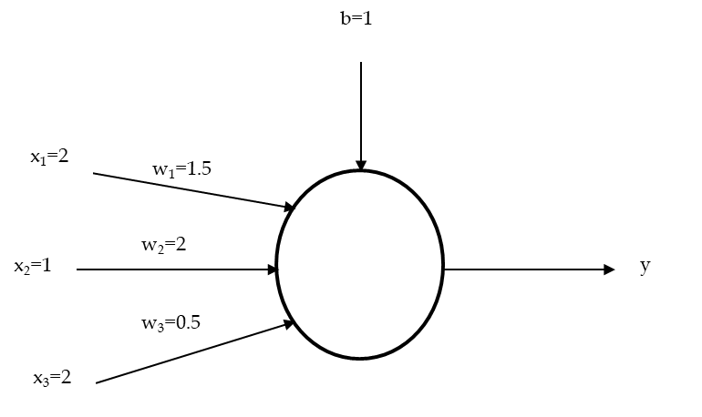
Example: Consider following stochastic neuron and compute its probability of firing by assuming T=5
u=x₁*w₁+x₂*w₂+x₃*w₃
=2*1.5+1*2+2*0.5=6
v=u+b=6+1=7
Now,
P(v)=1/(1+e^{-v/T})
=1/(1+e^{-7/5})=0.802
Thus, the probability of firing the neuron is 0.802

Slide 11
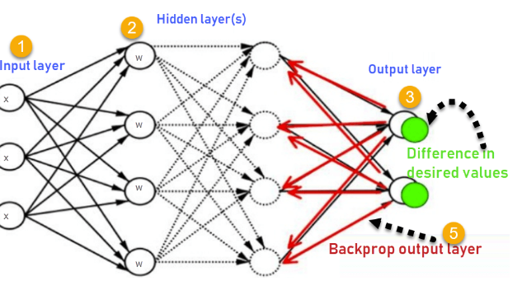
How backpropagation algorithm works
The backpropagation algorithm in neural network computes the gradient of the loss function for a single weight by the chain rule. It efficiently computes one layer at a time, unlike a native direct computation. It computes the gradient, but it does not define how the gradient is used. It generalize the computation in the delta rule.
Consider the following Back propagation neural network example diagram to understand:

Slide 12
How Backpropagation Algorithm works
1. Inputs X, arrive through the pre-connected path
2. Input is modeled using real weights W. the weights are usually randomly selected
3. Calculate the output for every neuron from the Input layer, to the hidden layers, to the output layer
4. Calculate the error in the outputs
Error= Actual Output-Desired Output
5. Travel back from the output layer to the hidden layer to adjust the weights such that the error is minimized
Keep repeating the process until the desired output is achieved

Slide 13
Backpropagation algorithm
Example
Consider a MLP given below. Let the learning rate be 1. The initial weights of the network are given in the table below. Assume that first training tuple is (1, 0, 1) and its target output is 1. Calculate weight updates by using back-propagation algorithm. Assume .

Slide 14
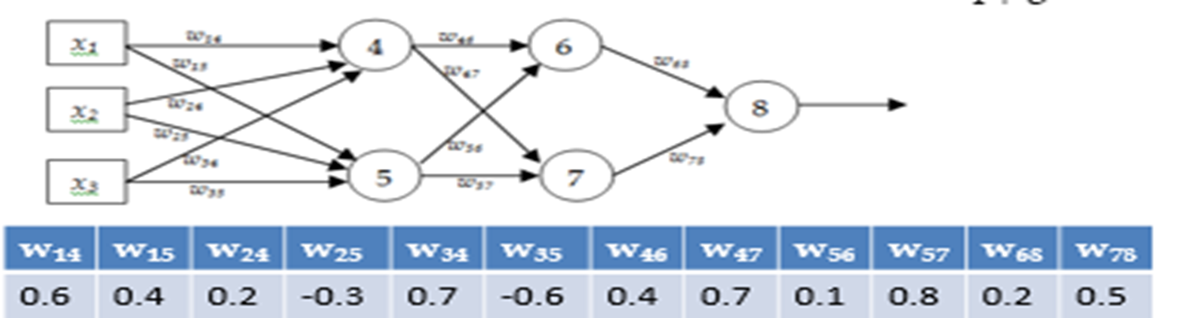

Slide 15
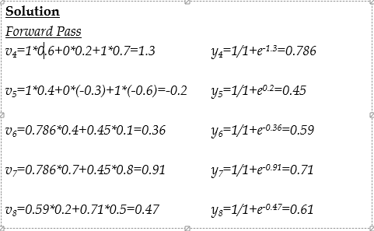

Slide 16
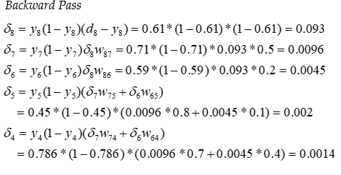

Slide 17
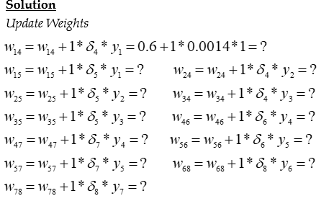

Slide 18
Gate Realization using neural network
"Gate realization using neural networks" refers to the process of implementing logical gates (such as AND, OR, NOT, XOR, etc.) using artificial neural networks (ANNs). Neural networks are computational models inspired by the human brain, capable of learning and performing complex tasks by adjusting their weights and biases through training.
Logical Gates:
Logical gates are the building blocks of digital circuits, performing basic Boolean operations.
Examples:
AND Gate: Outputs true only if all inputs are true.
OR Gate: Outputs true if at least one input is true.
NOT Gate: Inverts the input.
XOR Gate: Outputs true if the inputs are different.

Slide 19
Gate Realization:
A neural network can be trained or designed to mimic the behavior of logical gates.
For example, a simple perceptron (a single-layer neural network) can represent AND, OR, and NOT gates by adjusting its weights and biases.
More complex gates like XOR require multi-layer networks (e.g., a feedforward neural network with at least one hidden layer).

Slide 20
Steps to Realize Gates Using Neural Networks:
Define the Problem:
Specify the logical gate to be implemented (e.g., AND, OR, XOR).
Design the Network:
Choose the architecture (e.g., number of layers, neurons, activation functions).
For simple gates, a single-layer perceptron may suffice.
For XOR, a multi-layer perceptron (MLP) with at least one hidden layer is required.
Train the Network:
Use a dataset of input-output pairs corresponding to the gate's truth table.
Apply a learning algorithm (e.g., gradient descent) to adjust the weights and biases.
Test the Network:
Verify that the network produces the correct outputs for all possible inputs

Slide 21
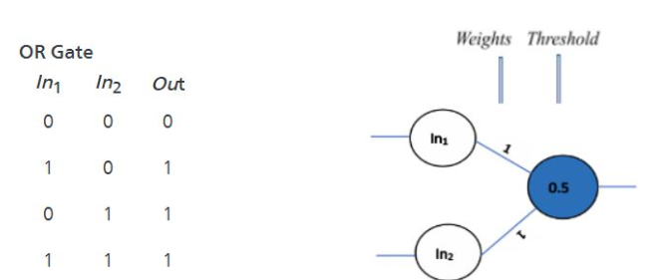
Simple OR Gate Realization

Slide 22
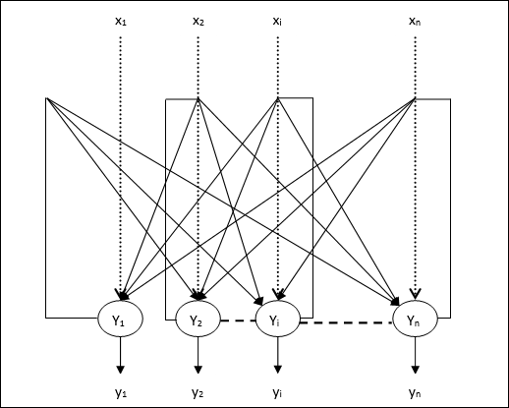
Hopfield neural Network
A Hopfield Network is a type of recurrent neural network that serves as a form of content-addressable memory.
It is designed to store and retrieve patterns, making it useful for tasks like pattern recognition and optimization.

Slide 23
Key Features:
Recurrent Architecture: Neurons are connected in a feedback loop, meaning the output of each neuron is fed back as input to other neurons.
Fully Connected: Every neuron is connected to every other neuron, but there are no self-connections (i.e., a neuron does not connect to itself).
Symmetric Weights: The weight matrix is symmetric (wij​=wji​).
Binary States: Neurons typically have binary states (e.g., 11 or −1−1).

Slide 24
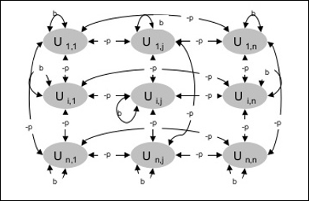
Boltzmann Machines
A Boltzmann Machine is a stochastic recurrent neural network that extends the Hopfield Network by introducing probabilistic behavior.

Slide 25
They use recurrent structure.
They consist of stochastic neurons, which have one of the two possible states, either 1 or 0.
Some of the neurons in this are adaptive freestate and some are clamped frozenstate
If we apply simulated annealing on discrete Hopfield network, then it would become Boltzmann Machine.

Slide 26
Natural language processing
Natural Language Processing (NLP) is a subfield of artificial intelligence (AI) and computational linguistics that focuses on enabling computers to understand, interpret, and generate human language. It bridges the gap between human communication and computer understanding, allowing machines to process and analyze large amounts of natural language data.
Core Components of NLP:
1. Syntax (Structure of Language):
Deals with the arrangement of words to form meaningful sentences.
Tasks:
Tokenization: Splitting text into words, phrases, or sentences.
Part-of-Speech (POS) Tagging: Identifying the grammatical role of each word (e.g., noun, verb, adjective).
Parsing: Analyzing the grammatical structure of a sentence.
Stemming and Lemmatization: Reducing words to their base or root form (e.g., "running" → "run").

Slide 27
2. Semantics (Meaning of Language):
Focuses on understanding the meaning of words, phrases, and sentences.
Tasks:
Named Entity Recognition (NER): Identifying entities like names, dates, and locations (e.g., "Apple" as a company).
Word Sense Disambiguation: Determining the correct meaning of a word in context (e.g., "bank" as a financial institution vs. a riverbank).
Semantic Role Labeling: Identifying the roles of words in a sentence (e.g., "who did what to whom").
3. Pragmatics (Context and Intent):
Deals with the use of language in context and the intended meaning.
Tasks:
Sentiment Analysis: Determining the emotional tone of text (e.g., positive, negative, neutral).

Slide 28
Coreference Resolution: Identifying when two words refer to the same entity (e.g., "John said he is coming" → "he" refers to "John").
Discourse Analysis: Understanding how sentences connect to form coherent text.
Preprocessing steps in Natural Language Processing(NLP)
Tokenization: We break down the text into tokens.
example:
Text: the cat sat on the bed. Tokens: the, cat, sat, on, the, bed
2. Stemming: We remove the prefixes and suffixes to obtain the root word.
List of words: Affection, affects, affecting, affected,
Root word: Affect

Slide 29
3. Lemmatization: we group together different inflected forms of a word into a base word called lemma.
list of words: going, gone, went
lemma: go
4. POS tagging: we identify the parts of speech for different tokens
sentence: the dog killed the bat.
parts of speech: Definite article, noun, verb
5.Named entity recognition: We classify named entities mentioned in the text into categories such as “people”, “locations”,”organization”, and so on.
text: Google CEO Sundar Pichai resides in New York.
Named entity recognition:
Google-=Organization
Sundar Pichai = Person
New York= Location
6. Chunking: we pick up individual pieces of information and group them into bigger pieces.

